Slide 1

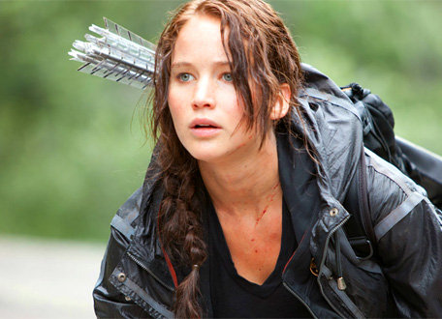
Starter: Summarise the chapter you read for homework in exactly 33 words.
Learning Objective: To consider how the writer builds tension.

Slide 2
Chapter 24

Slide 3
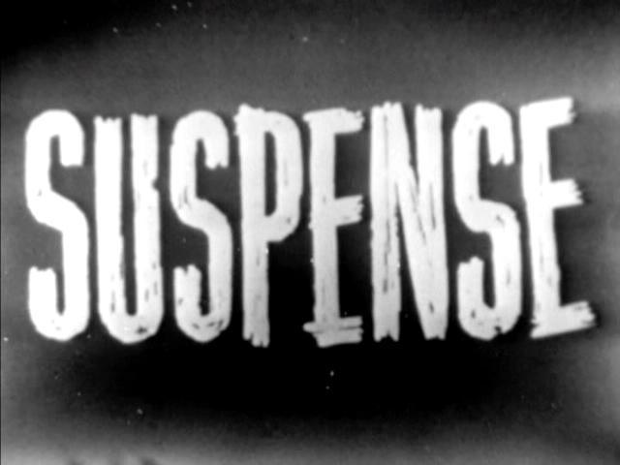
Learning Objective: To consider how the writer builds tension.
Short sentences force the reader to read faster . This suggests an impending climax: something dramatic is about to happen. This works to increase tension . It also allows the reader to empathise with the tension felt by the character (as they are experiencing the same emotions), further enhancing suspense.
Just in time, too, because Cato is upon us. I brace myself, but he rockets right between us with no attempt to check his speed. I can tell from his panting, the sweat pouring off his purplish face, that he’s been running hard a long time. Not towards us. From something. But what ?
My eyes scan the woods just in time to see the first creature leap on to the plain. As I’m turning away, I see another half dozen join it. Then I am stumbling blindly after Cato with no thought of anything but to save myself.
I run for what seems like an eternity. My heart feels like it’s about to explode…
Task: Continue the description of Katniss’s escape; write at least a paragraph, and include two simple sentences to emphasise the most suspenseful moments in your episode.

Slide 4
Learning Objective: To consider how the writer builds tension.
Plenary: Peer assess each other’s work.
PA
Level 5: They have used short sentences in their description.
Level 6: They have used short sentences in their description to create tension.
I think your answer is currently a level because .
My favourite short sentence in your writing was
because .
Level 7: They have done everything for a level 6 and also included a variety of other sentence structures to ensure their writing is varied.

